Slide 1


1984
1990
2000
2006
2010
2014

Slide 2
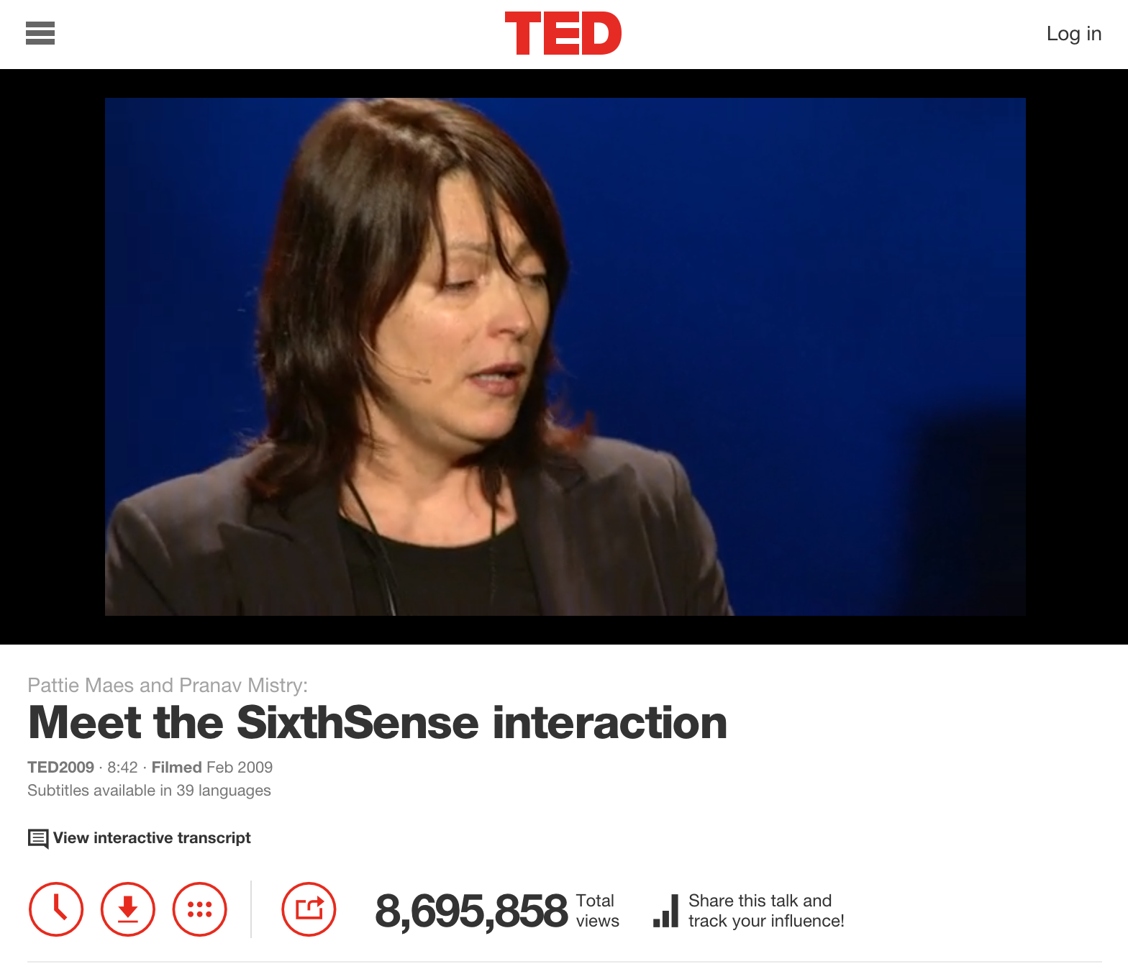
1984
1990
2000
.com
2006
2010
2014

Slide 3

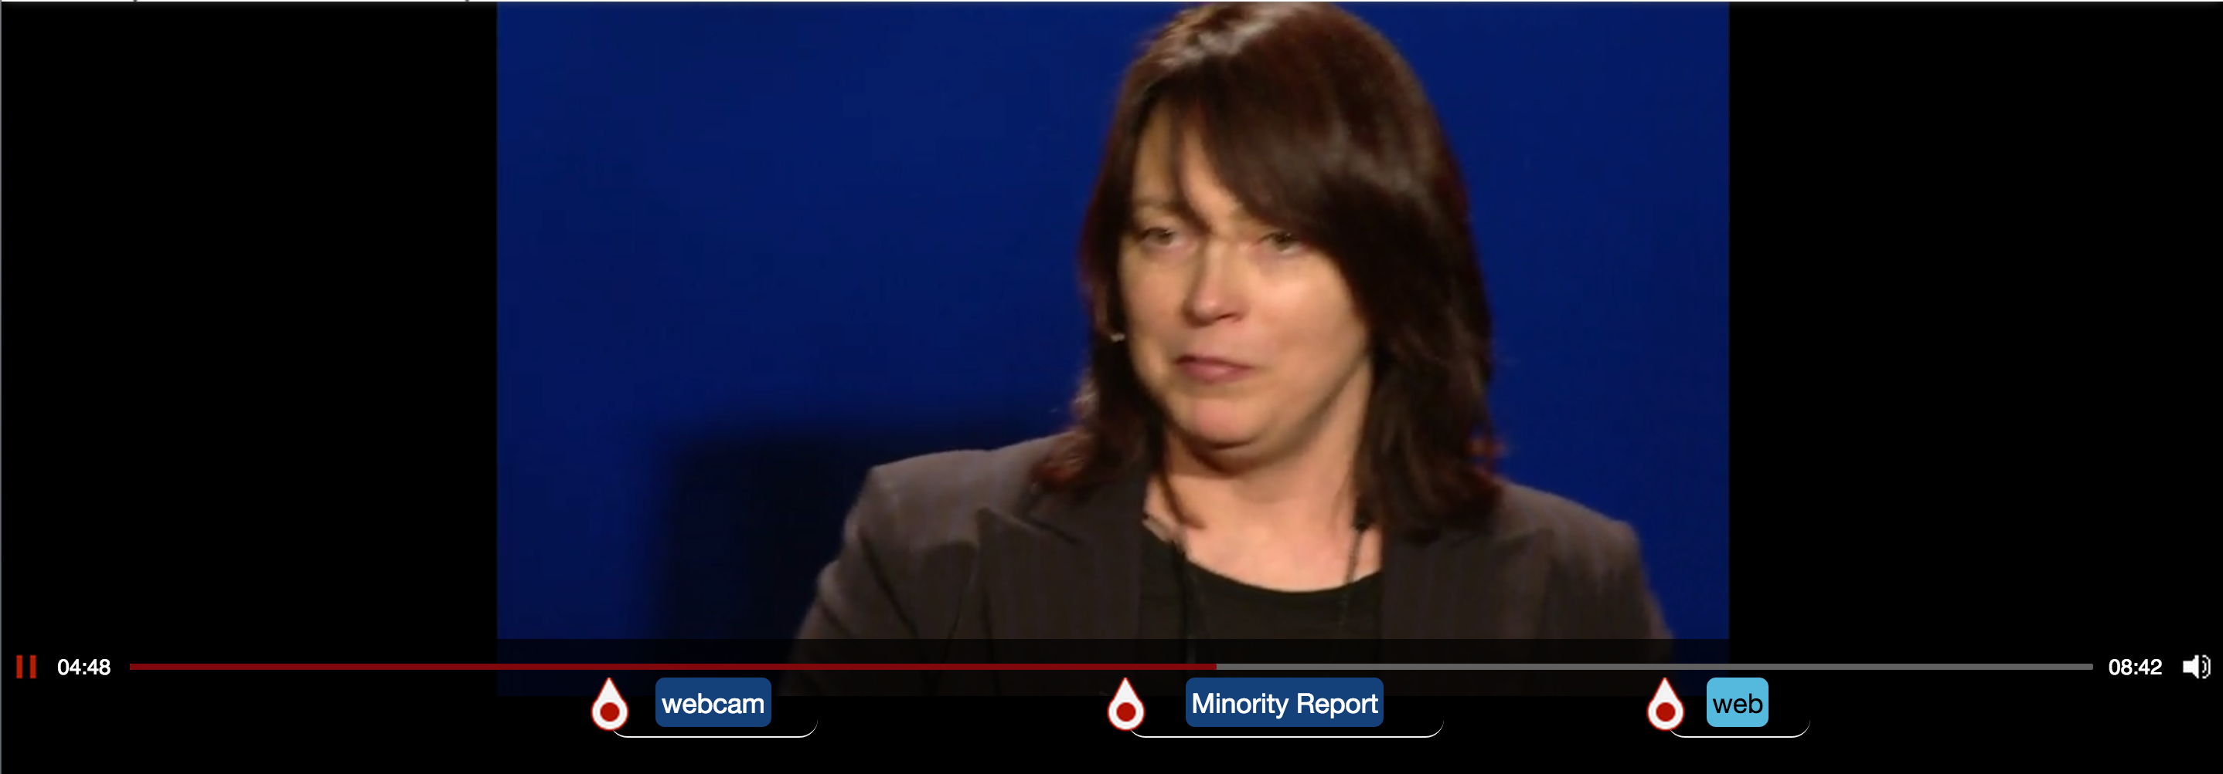
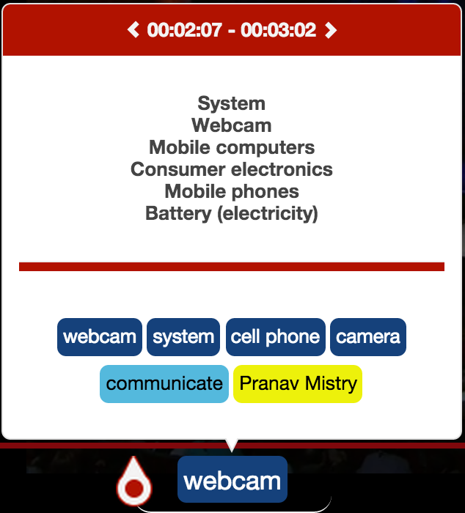
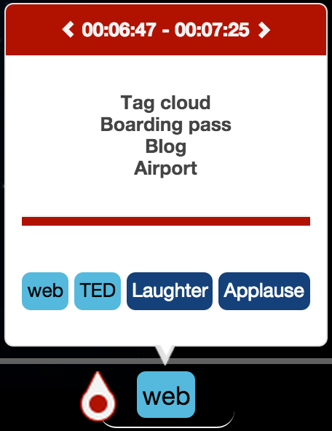




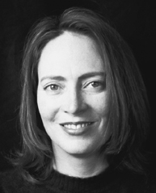


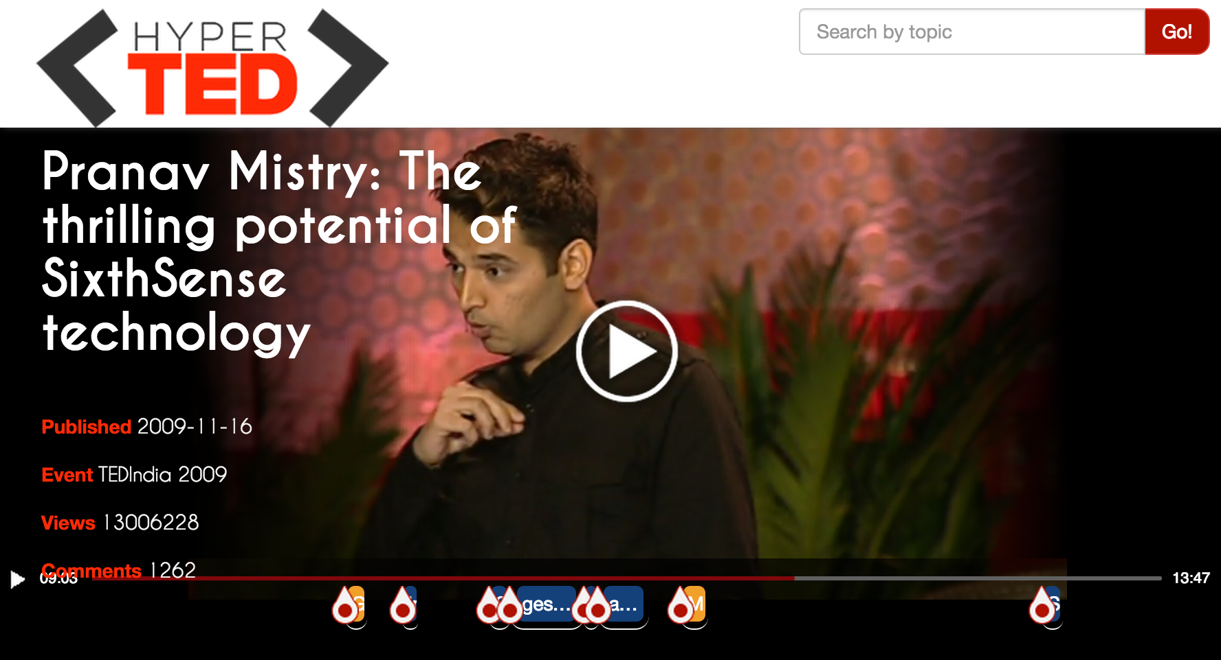

1984
1990
2000
.com
2006
2010
2014
Courses
Understanding environment:
A system approach
The Mysterious Field of Engineering Systems
Systems practice: Managing sustainability

